Slide 1

CSCI/ARTI 8950 Machine Learning
Lecture Notes 6: Clustering
Khaled Rasheed
Professor
School of Computing
Member
Institute for Artificial Intelligence
University of Georgia
Credit: some examples & figures by Marine Carpuat, Tom Mitchell & CIML

Slide 2
Exercise: When are DT vs kNN appropriate?
Properties of classification problem | Can Decision Trees handle them? | Can K-NN handle them?
Binary features
Numeric features
Categorical features
Robust to noisy training examples
Fast classification is crucial
Many irrelevant features
Relevant features have very different scale

Slide 3
Exercise: When are DT vs kNN appropriate?
Properties of classification problem | Can Decision Trees handle them? | Can K-NN handle them?
Binary features | yes | yes
Numeric features | yes | yes
Categorical features | yes | yes
Robust to noisy training examples | yes (with pruning) | yes (when k > 1)
Fast classification is crucial | yes | no
Many irrelevant features | yes | no
Relevant features have very different scale | yes | no

Slide 4
New Topics
A new algorithm
K-Means Clustering
Fundamental Machine Learning Concepts
Unsupervised vs. supervised learning

Slide 5
Clustering
Goal: automatically partition examples into groups of similar examples
Why? It is useful for
Automatically organizing data
Understanding hidden structure in data
Preprocessing for further analysis

Slide 6
What can we cluster in practice?
news articles or web pages by topic
protein sequences by function, or genes according to expression profile
users of social networks by interest
customers according to purchase history
…

Slide 7
Clustering
Input
a set S of n points in feature space
a distance measure specifying distance d(x_i,x_j) between pairs (x_i,x_j)
Output
A partition {S_1,S_2, … S_k} of S

Slide 8
Supervised Machine Learning as Function Approximation
Problem setting
Set of possible instances 𝑋
Unknown target function 𝑓: 𝑋 → 𝑌
Set of function hypotheses 𝐻 = ℎ ℎ: 𝑋 → 𝑌}
Input
Training examples { 𝑥 ¹ , 𝑦 ¹
target function 𝑓
Output
, … 𝑥 ^{𝑁} , 𝑦 ^{𝑁} } of unknown
Hypothesis ℎ ∈ 𝐻 that best approximates target function 𝑓

Slide 9
Supervised
vs. unsupervised learning
Clustering is an example of unsupervised learning
We are not given examples of classes y
Instead we have to discover classes in data

Slide 10
Unsupervised Learning
Input: Training set
Output: Structure of training set, e.g., clusters
Representative Approaches
Clustering
Represent each sample using a prototype example
Dimensionality Reduction
Represent each sample using a small number of variables (e.g., feature selection, feature extraction)
Density Estimation
Estimate the probability distribution over the data space

Slide 11
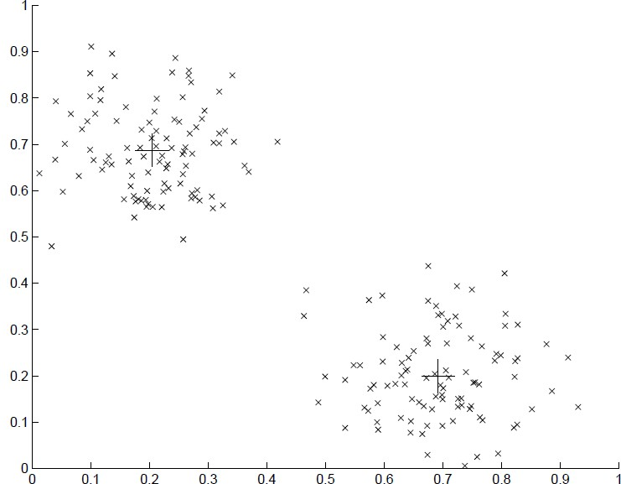
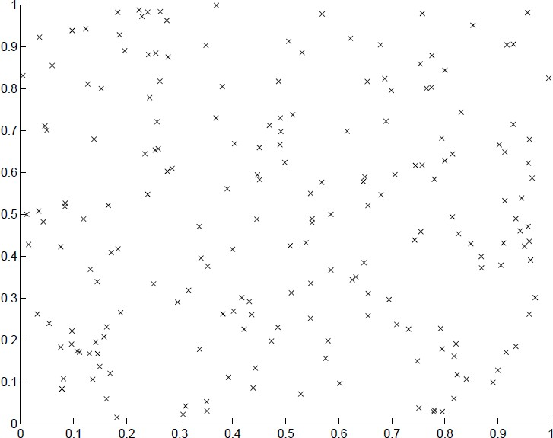
2 datasets with very different underlying structure!

Slide 12
Clustering
What is a cluster?
A cluster is a collection of data objects which are
Similar (or related) to one another within the same group (i.e., cluster)
Dissimilar (or unrelated) to the objects in other groups (i.e., clusters)
Cluster analysis (or clustering, data segmentation, …)
Given a set of data points, partition them into a set of groups (i.e., clusters) which are as similar as possible
Cluster analysis is unsupervised learning (i.e., no predefined classes)
This contrasts with classification (i.e., supervised learning)
Typical ways to use/apply cluster analysis
As a stand-alone tool to get insight into data distribution, or
As a preprocessing (or intermediate) step for other algorithms

Slide 13
Clustering
A good clustering method will produce high quality clusters which should have
High intra-class similarity: Cohesive within clusters
Low inter-class similarity: Distinctive between clusters
Quality function
There is usually a separate “quality” function that measures the “goodness” of a cluster
It is hard to define “similar enough” or “good enough” (highly subjective)
There exist many similarity measures and/or functions for different applications
Similarity measure is critical for cluster analysis

Slide 14
Clustering: Applications
A key intermediate step for other data mining tasks
Generating a compact summary of data for classification, pattern discovery, hypothesis generation and testing, etc.
Outlier detection: Outliers—those “far away” from any cluster
Data summarization, compression, and reduction
Ex. Image processing: Vector quantization
Collaborative filtering, recommendation systems, or customer segmentation
Find like-minded users or similar products
Dynamic trend detection
Clustering stream data and detecting trends and patterns
Multimedia data analysis, biological data analysis and social network analysis
Ex. Clustering images or video/audio clips, gene/protein sequences, etc.

Slide 15
Clustering: Algorithm Design
Partitioning criteria
Single level vs. hierarchical partitioning (often, multi-level hierarchical partitioning is desirable, e.g., grouping topical terms)
Separation of clusters
Exclusive (e.g., one customer belongs to only one region) vs. non- exclusive (e.g., one document may belong to more than one class)
Similarity measure
Distance-based (e.g., Euclidean) vs. connectivity-based (e.g., density or contiguity)
Clustering space
Full space (often when low dimensional) vs. subspaces (often in high-dimensional clustering)

Slide 16
Clustering: Requirements & Challenges
Quality
Ability to deal with different types of attributes: Numerical, categorical, text, multimedia, networks, and mixture of multiple types
Discovery of clusters with arbitrary shape
Ability to deal with noisy data
Scalability
High dimensionality
Incremental or stream clustering and insensitivity to input order
Constraint-based clustering
User-given preferences or constraints; domain knowledge; user queries
Interpretability and usability
The final generated clusters should be semantically meaningful and useful

Slide 17
Major Clustering Algorithms
Partitioning approach (Covered in this lecture)
Construct various partitions and then evaluate them by some criterion, e.g., minimizing the sum of square errors
Typical methods: k-means, k-medoids, CLARANS
Hierarchical approach (mentioned in this lecture)
Create a hierarchical decomposition of the set of data (or objects) using some criterion
Typical methods: Diana, Agnes, BIRCH, CAMELEON
Density-based approach
Based on connectivity and density functions
Typical methods: DBSACN, OPTICS, DenClue
Grid-based approach
based on a multiple-level granularity structure
Typical methods: STING, WaveCluster, CLIQUE

Slide 18
Clustering: Partitioning Approach
Problem definition: Given K, find a partition of K clusters that optimizes the chosen partitioning criterion
A typical objective function: Sum of Squared Errors (SSE)
K
SSE(C) = ∑ ∑|| x −c ||²
i
k
k =1 x_{i∈Ck}
Global optimal: Needs to exhaustively enumerate all partitions
Heuristic methods (i.e., greedy algorithms): K-Means, K-Medians, K- Medoids, etc

Slide 19
K-Means Clustering
K-Means (MacQueen’67, Lloyd’57/’82)
Each cluster is represented by the center of the cluster
Given K, the number of clusters, the K-Means clustering algorithm is outlined as follows
Select K points as initial centroids
Repeat
Form K clusters by assigning each point to its closest centroid
Re-compute the centroids (i.e., mean point) of each cluster
Until convergence criterion is satisfied
Different kinds of measures can be used
Manhattan distance (L₁ norm), Euclidean distance (L₂ norm), Cosine similarity

Slide 20
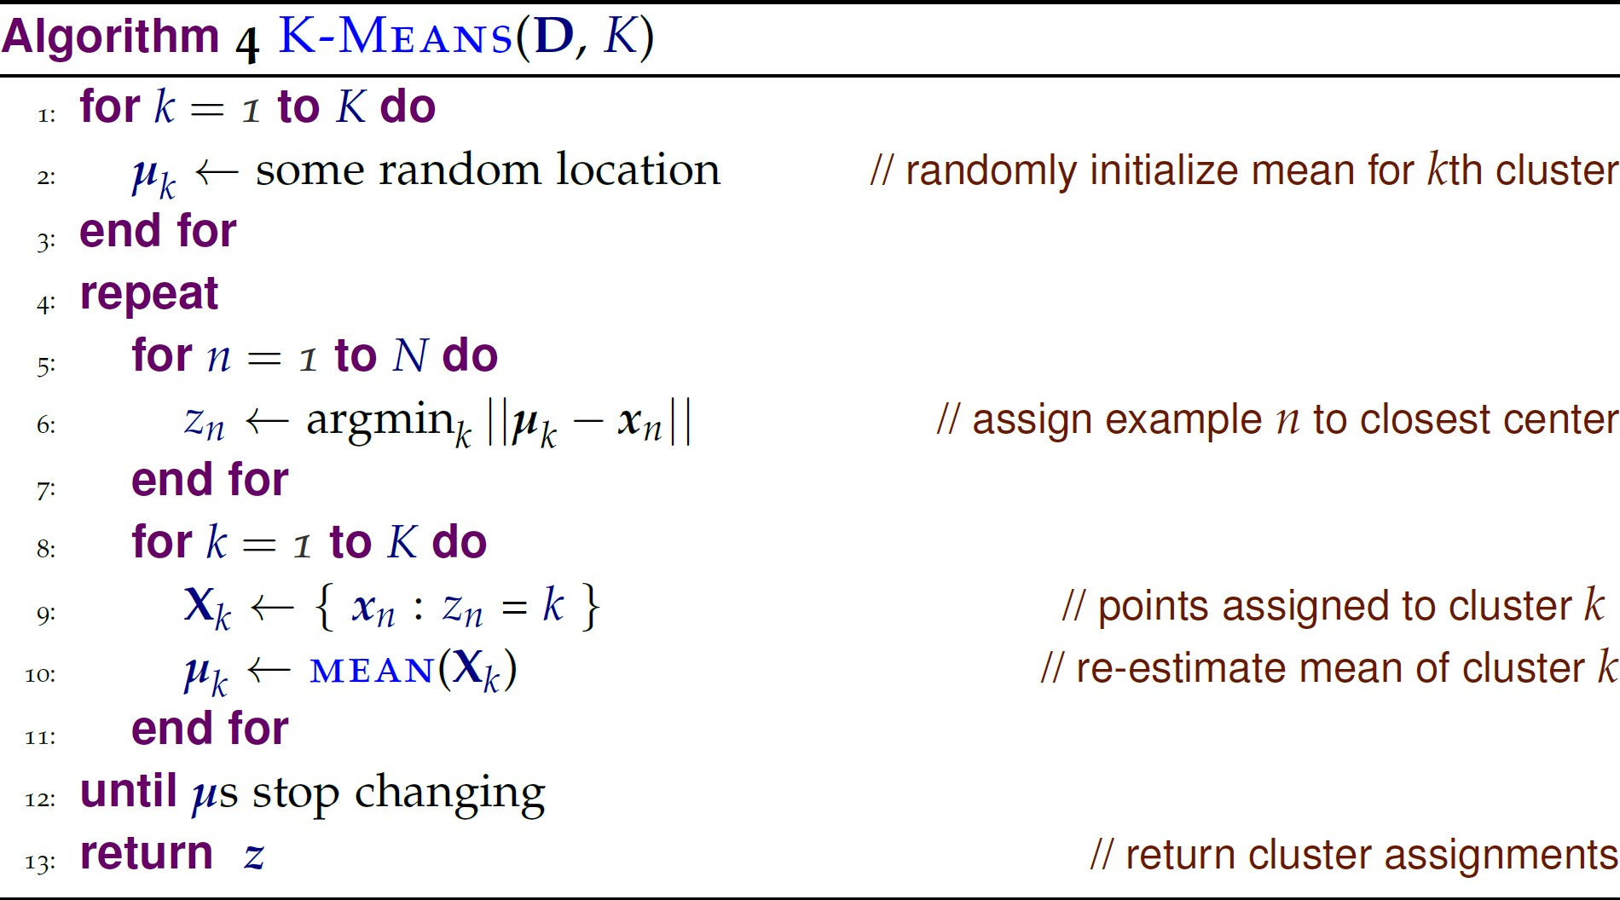
The K-Means Algorithm
K: number of
Training Data
clusters to
discover

Slide 21
Example: using K-Means to discover 2 clusters in data

Slide 22
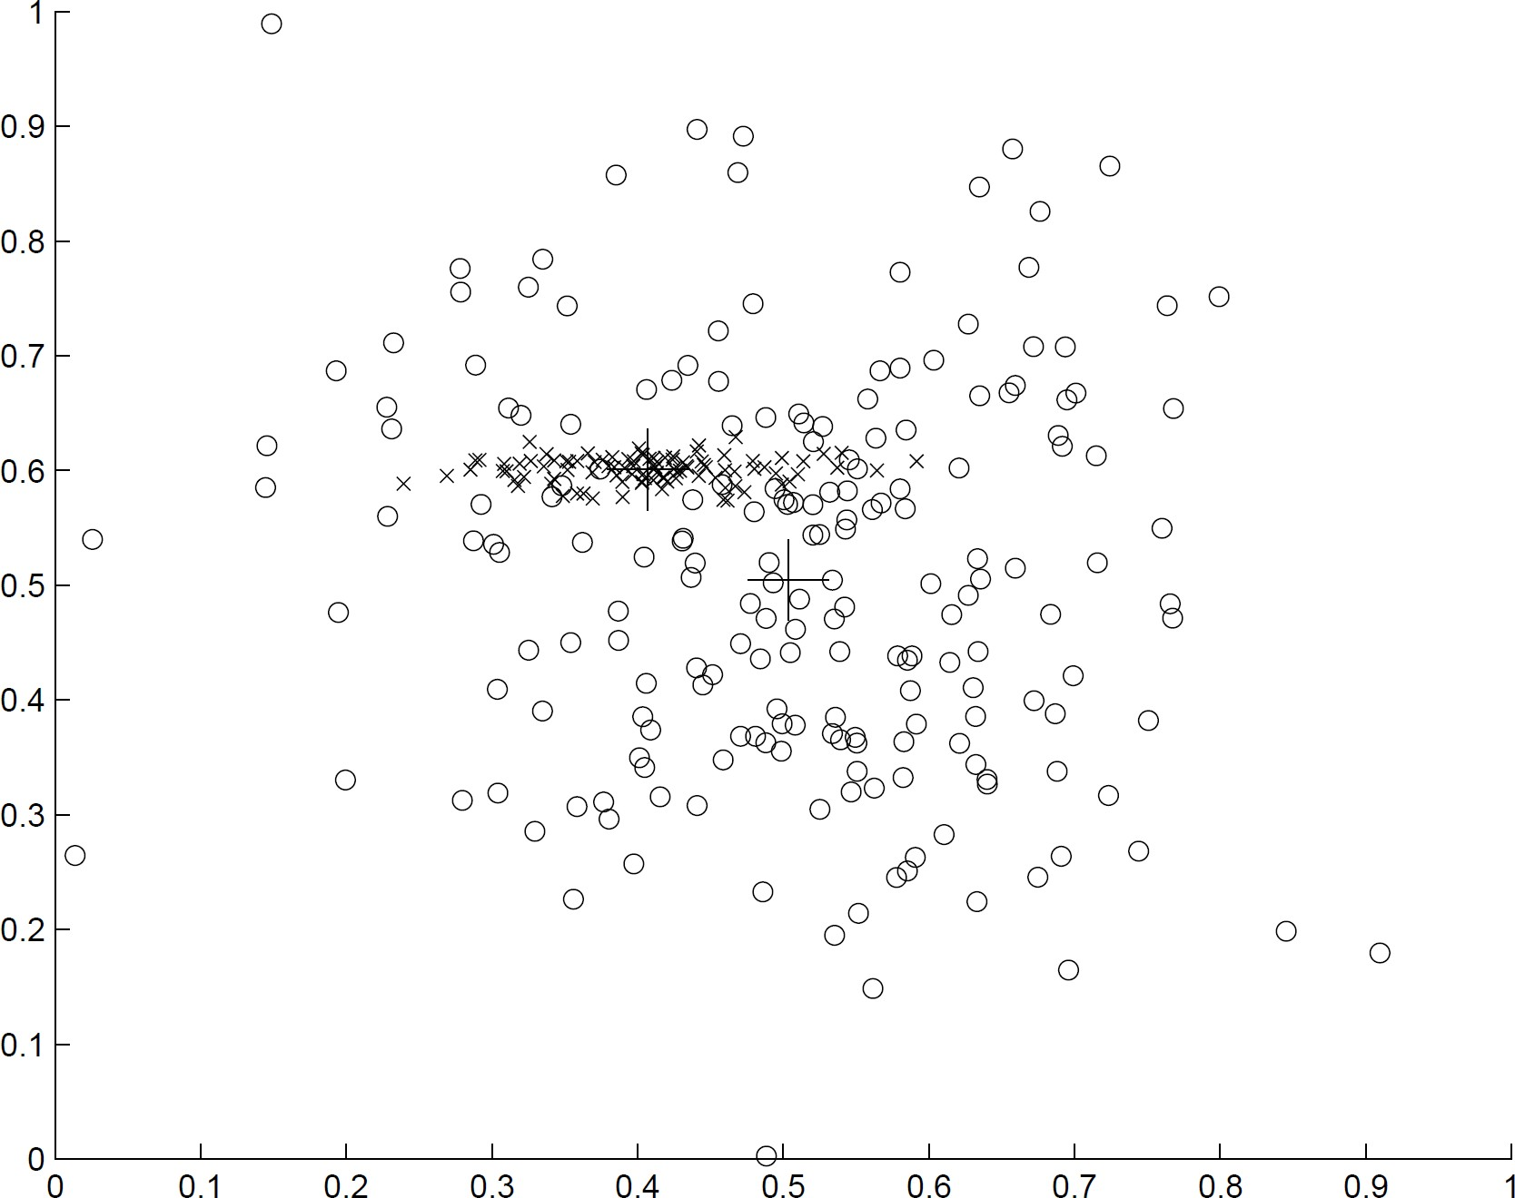
Example: using K-Means to discover 2 clusters in data

Slide 23

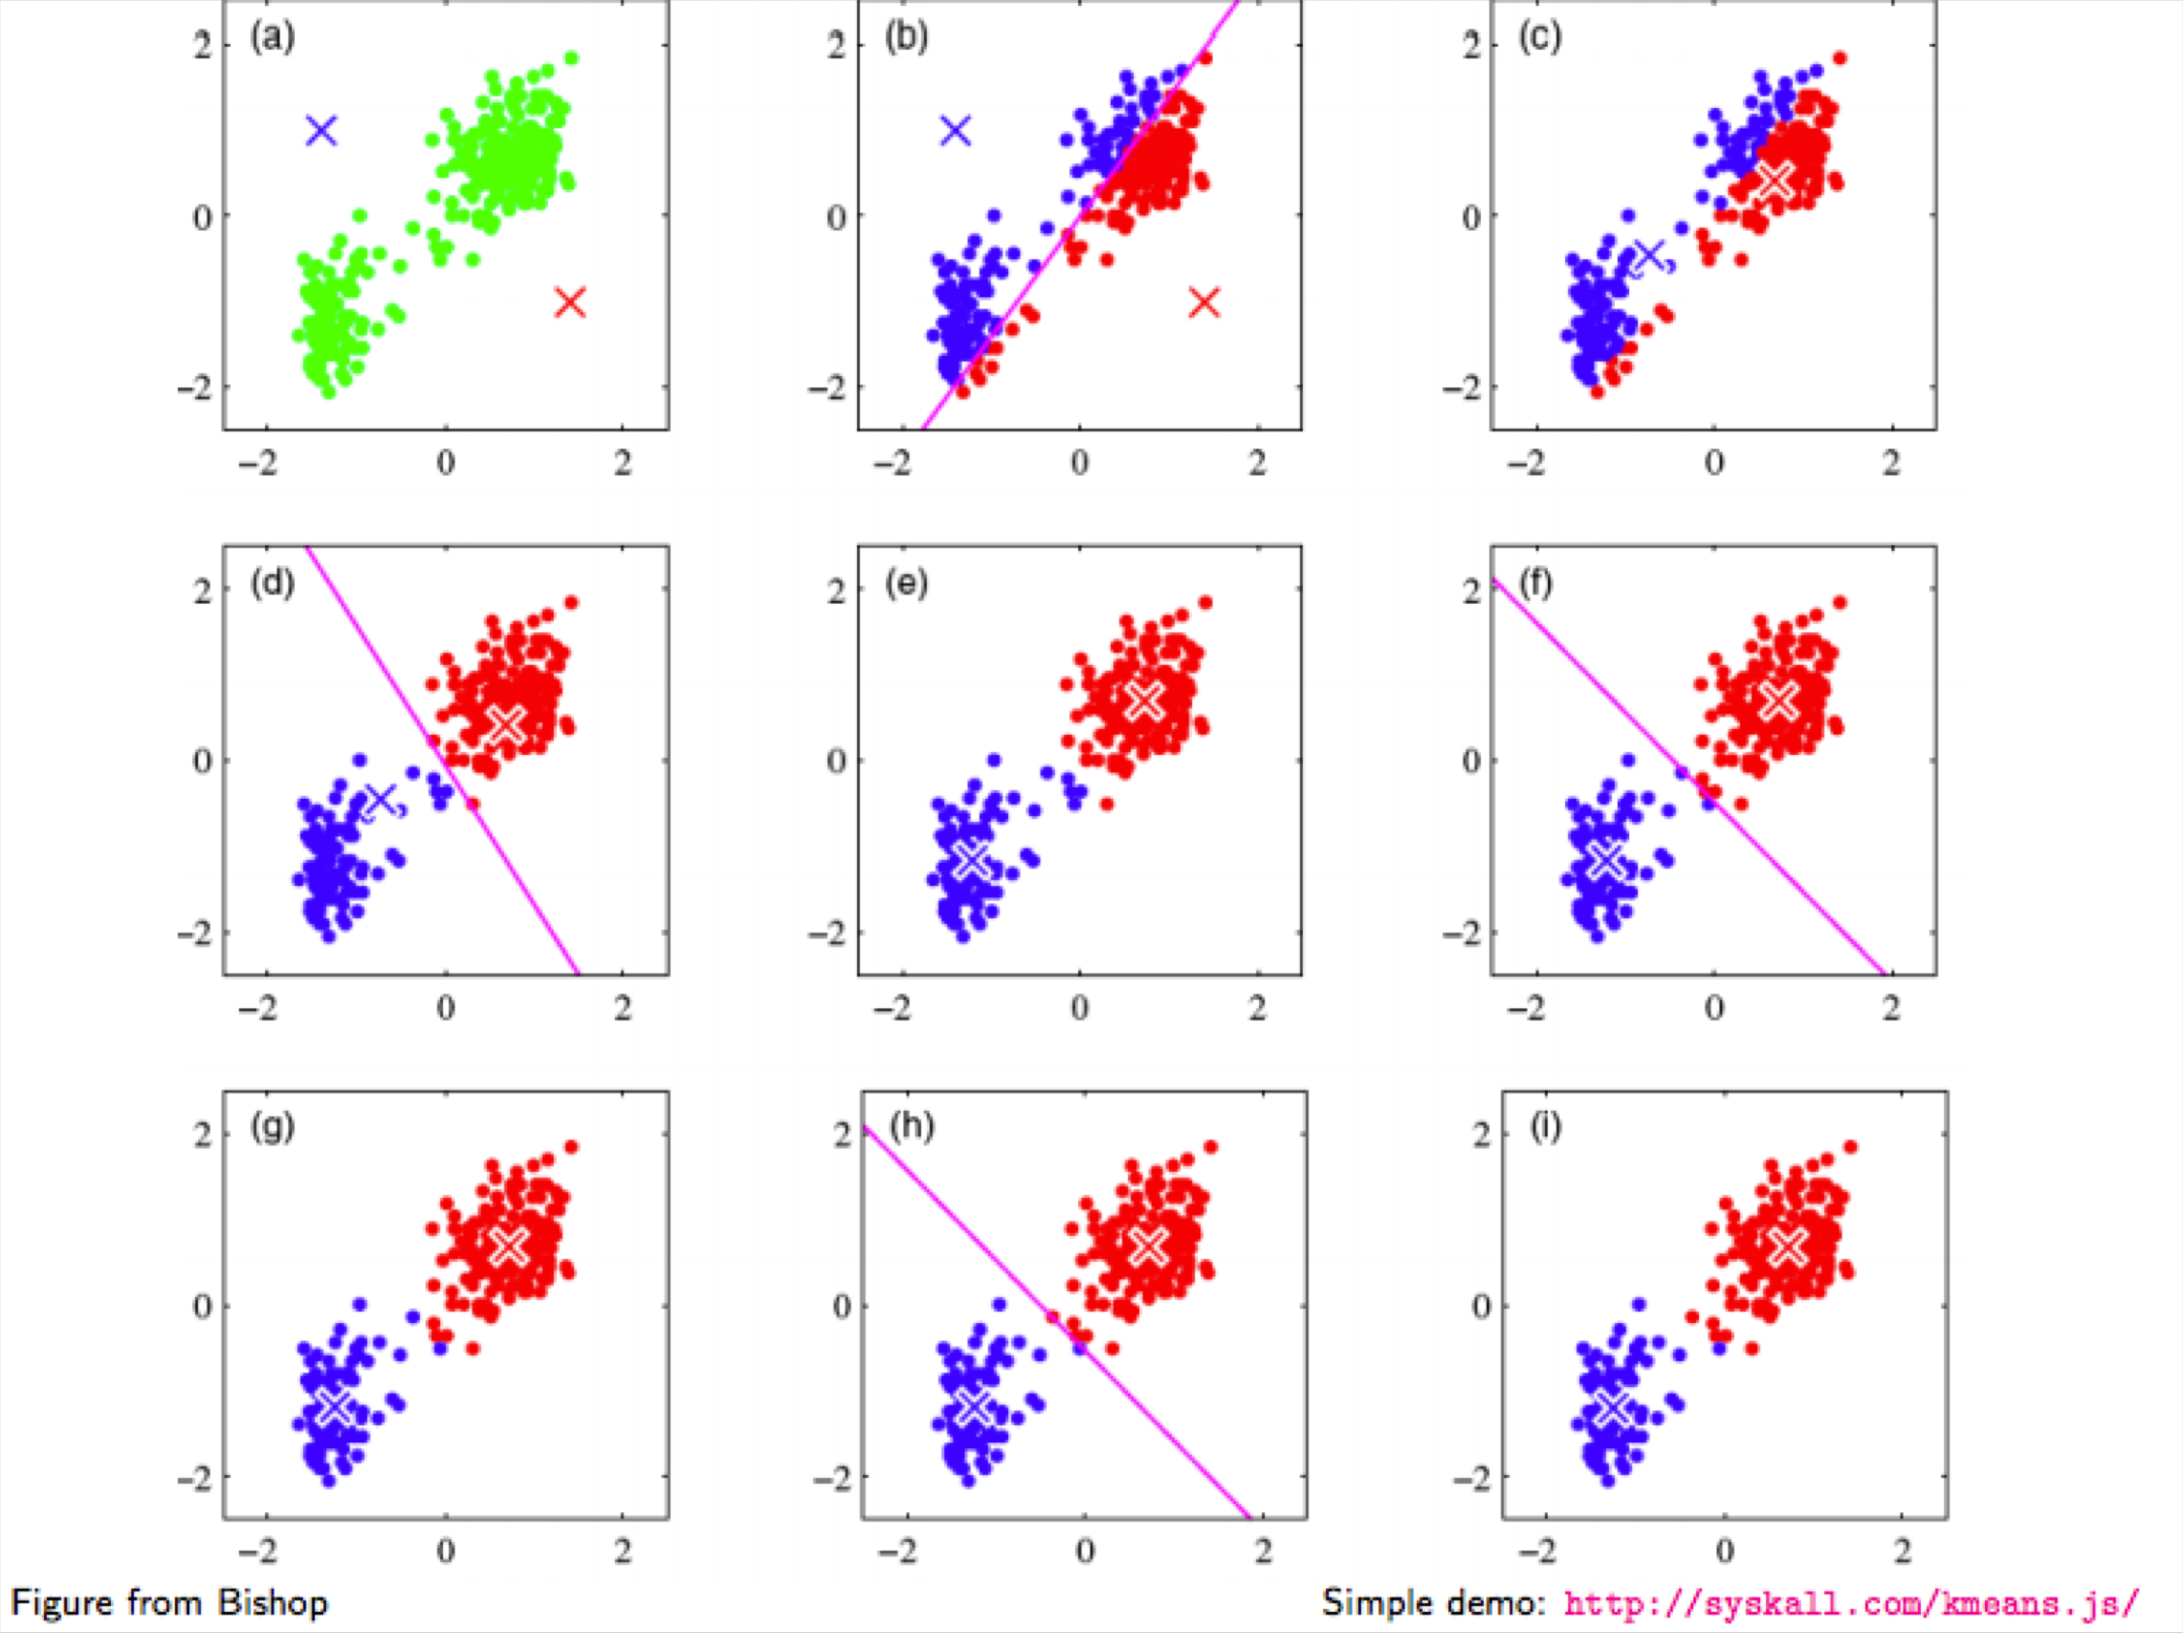
K-Means Clustering: Example

Slide 24
K-Means properties
Time complexity: O(KNt) where
K is the number of clusters
N is number of examples
t is the number of iterations
K is a hyperparameter
Needs to be set in advance (or learned experimentally)
Different initializations yield different results!
Doesn’t necessarily converge to best partition
“Global” view of data: revisits all examples at every iteration

Slide 25
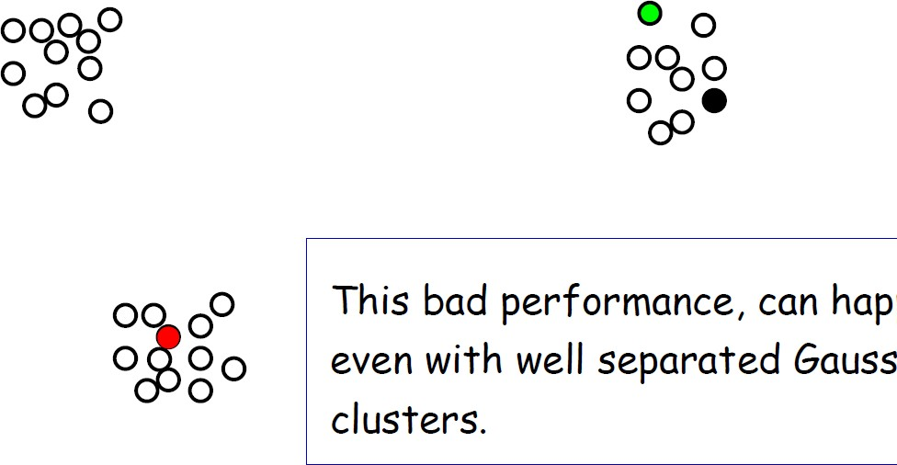
Impact of initialization

Slide 26
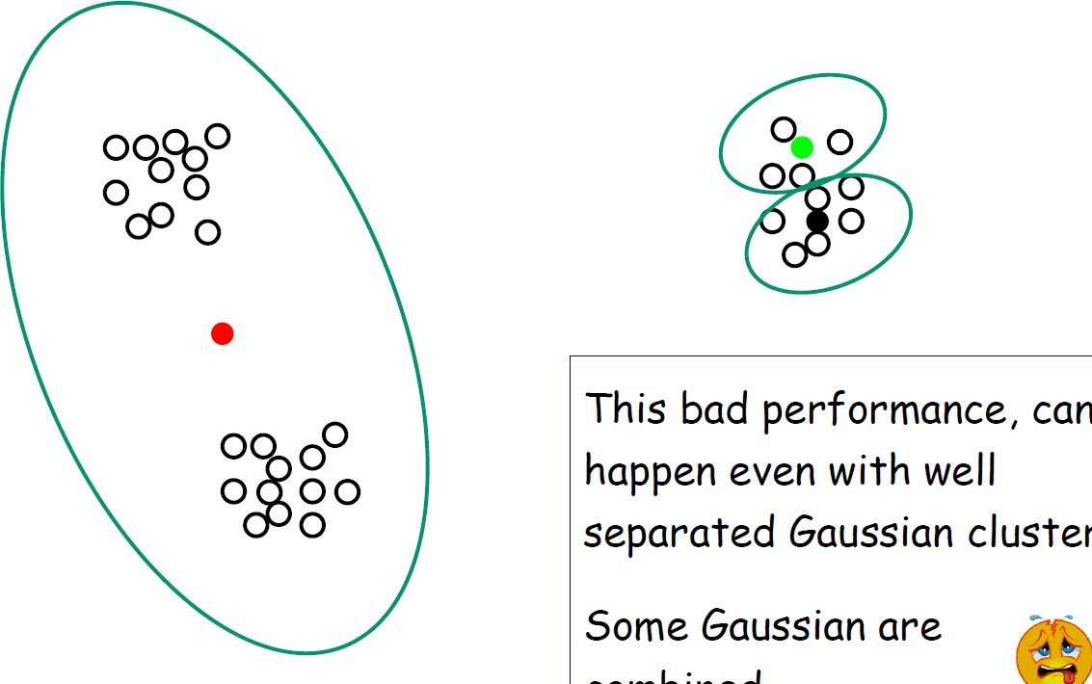
Impact of initialization

Slide 27
Questions for you…
Are there clusters that cannot be discovered using k-means?
Do you know any other clustering algorithms?

Slide 28
K-Means Clustering: Discussions
Efficiency: O(tKn) where n: # of objects, K: # of clusters, and t: # of iterations
Normally, K, t << n; thus, an efficient method
K-means clustering often terminates at a local optimum
Initialization can be important to find high-quality clusters
Need to specify K, the number of clusters, in advance
There are ways to automatically determine the “best” K
In practice, run a range of values and selected the “best” K value
Sensitive to noisy data and outliers
K-means is applicable only to objects in a continuous n-dimensional space, e.g., using the K-modes for categorical data
Not suitable to discover clusters with non-convex shapes
Using density-based clustering, kernel K-means, etc.

Slide 29
Variations of K-Means Clustering
There are many variants of the K-Means Clustering method
Choosing better initial centroid estimates
K-means++, Intelligent K-Means, Genetic K-Means
Choosing different representative prototypes for the clusters
K-Medoids, K-Medians, K-Modes
Applying feature transformation techniques
Weighted K-Means, Kernel K-Means

Slide 30
Hierarchical clustering
Bisecting k-means performs hierarchical clustering in a top-down manner (divisive clustering)
Standard hierarchical clustering performs clustering in a bottom-up manner; it performs agglomerative clustering:
First, make each instance in the dataset into a trivial mini-cluster
Then, find the two closest clusters and merge them; repeat
Clustering stops when all clusters have been merged into a single cluster
Outcome (usually a dendrogram) is determined by the distance function that is used:
Single-linkage clustering: distance of two clusters is measured by finding the two closest instances, one from each cluster, and taking their distance
Complete-linkage clustering: use the two most distant instances instead
Average-linkage clustering: take average distance between all instances
Centroid-linkage clustering: take distance of cluster centroids
[Source: Data Mining by Witten, Frank, Hall and Pal]

Slide 31
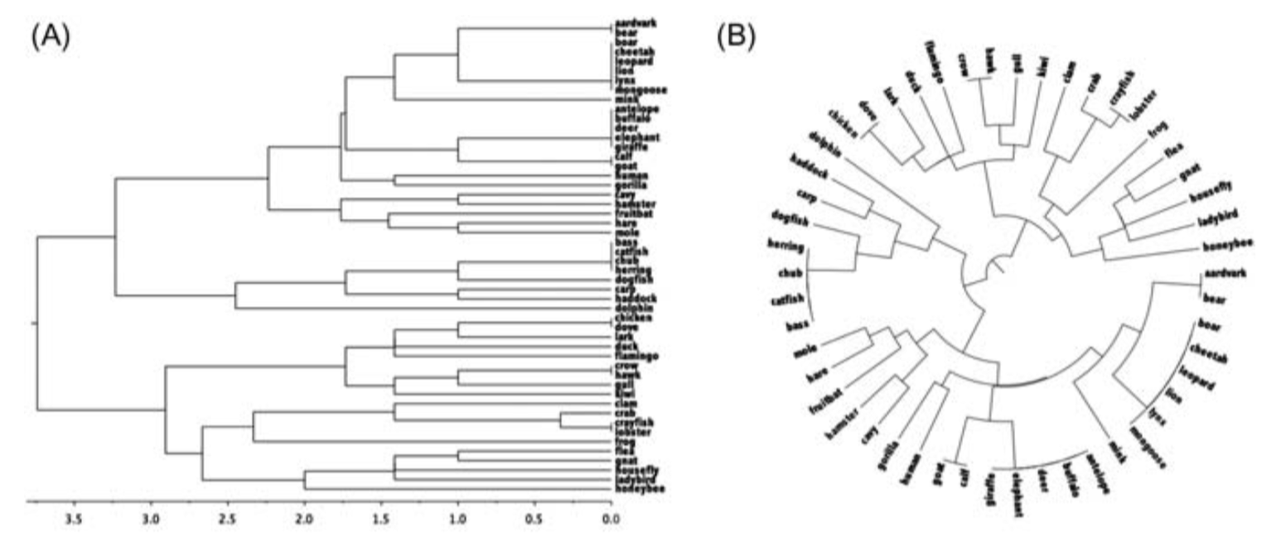
Example: complete linkage dendrogram
[Source: Data Mining by Witten, Frank, Hall and Pal]

Slide 32
Clustering Validation and Assessment
Clustering evaluation
Evaluating the goodness of the clustering
Clustering stability
To understand the sensitivity of the clustering result to various algorithm parameters, e.g., # of clusters
Clustering tendency
Assess the suitability of clustering, i.e., whether the data has any inherent grouping structure
Remember that there is no “correct” answer. Most methods compare two different clusterings of the same samples.

Slide 33
Clustering Validation and Assessment
Extrinsic Measures
require ground truth labels.
Examples are Adjusted Rand index, Fowlkes-Mallows scores, Mutual information based scores, Homogeneity, Completeness, F-measure and V-measure
Intrinsic Measures
do not require ground truth labels
Silhouette Coefficient, Calinski-Harabasz Index, Davies-Bouldin Index

Slide 34
What you should know
New Algorithms
K-NN classification
K-means clustering
Fundamental ML concepts
How to draw decision boundaries
What decision boundaries tells us about the underlying classifiers
The difference between supervised and unsupervised learning

